Slide 1

Young’s Double Slit Experiment
MD. GULAM MUSTAFA
Lecturer (Physics)
Department of Science & Humanities
Bangladesh Army International University of Science and Technology (BAIUST)
Syedpur, Cumilla-3501

Slide 2

Whatever we will discuss
Young’s double slit experiment
Expression for the distance between two successive bright fringes
Expression for the distance between two successive dark fringes
Related mathematical problems

Slide 3
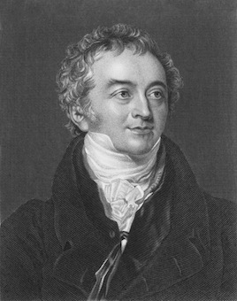
Young’s Double Slits Experiment
The experiment is named for its inventor,
Thomas Young (1773-1829).
Thomas Young’s experiment in 1805 proved
the wave nature of light by observing the
phenomenon of Interference.

Slide 4
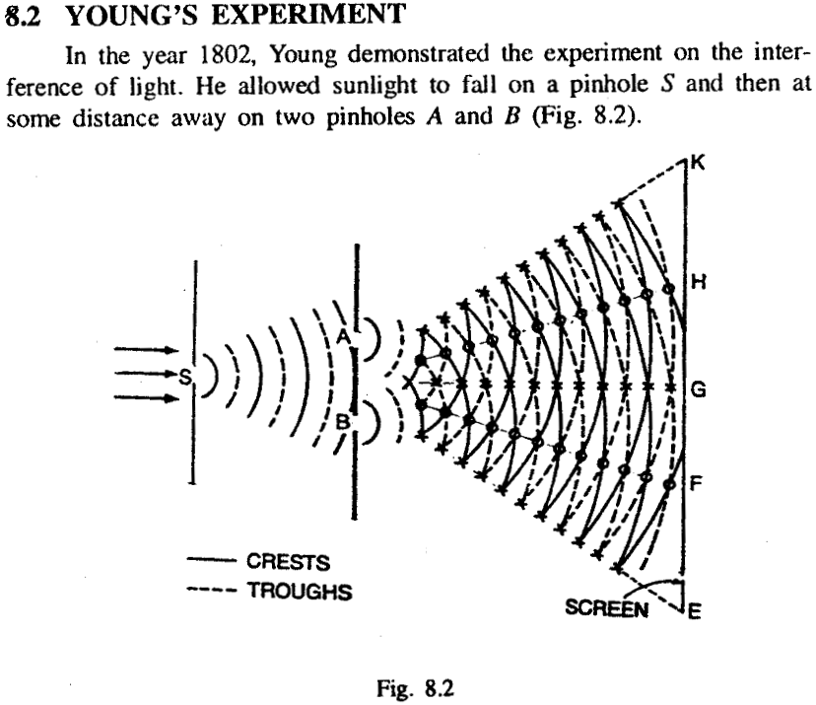
Young’s Double Slit Experiment

Slide 5
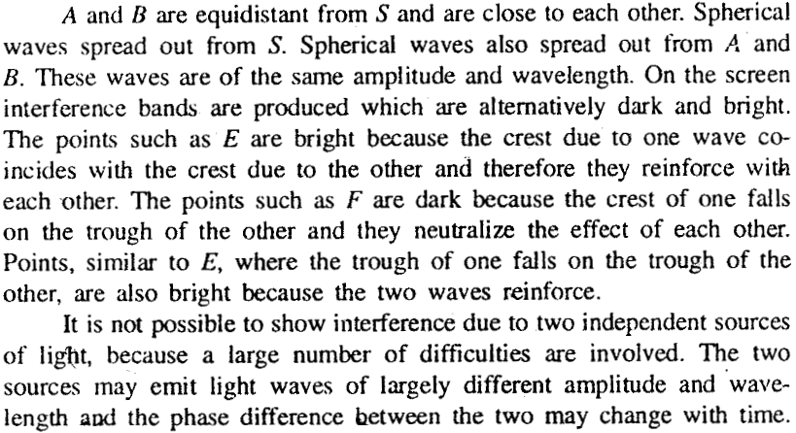

Slide 6

Fringe width & Fringe Breadth
Distance between two successive Bright Fringes, β₁ = (λD)/d
Distance between two successive Dark Fringes, β₂ = (λD)/d
Therefore, β₁ = β₂
The breadth of a bright or a dark fringe is equal to half of the distance between two successive bright or dark fringes.
i.e., Fringe breadth = (λD)/2d

Slide 7
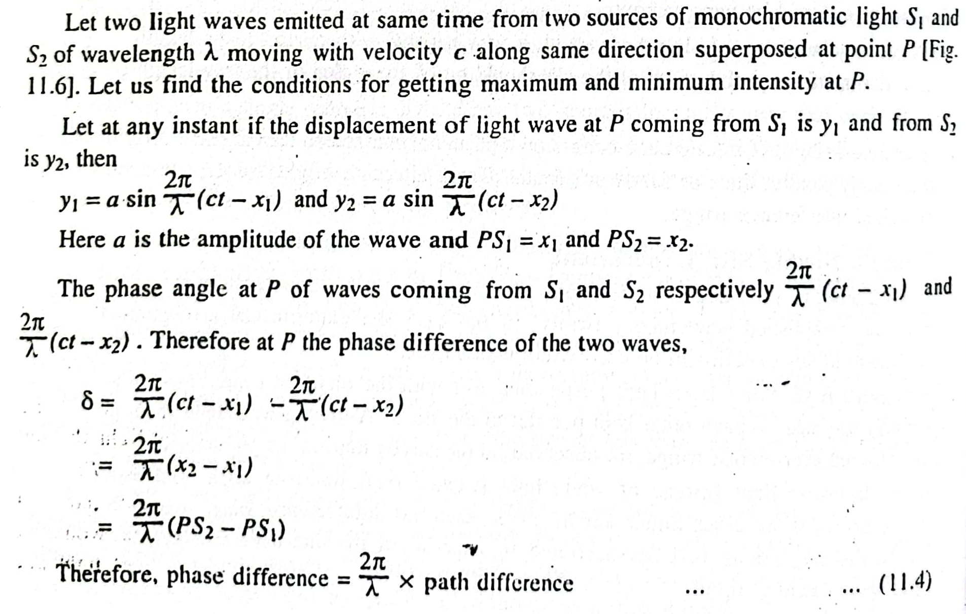
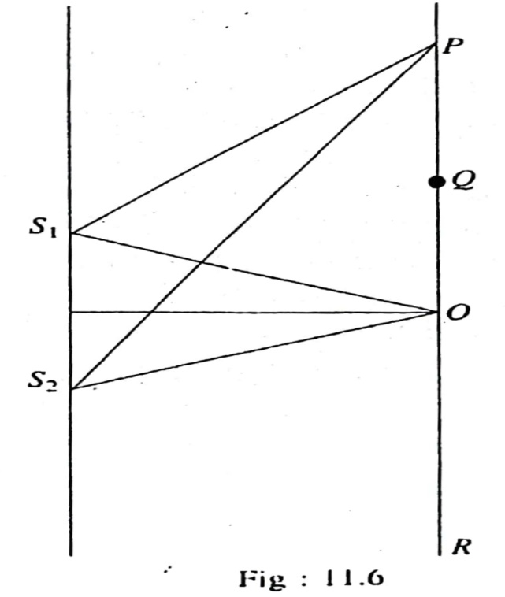
Relation between phase difference & path difference

Slide 8
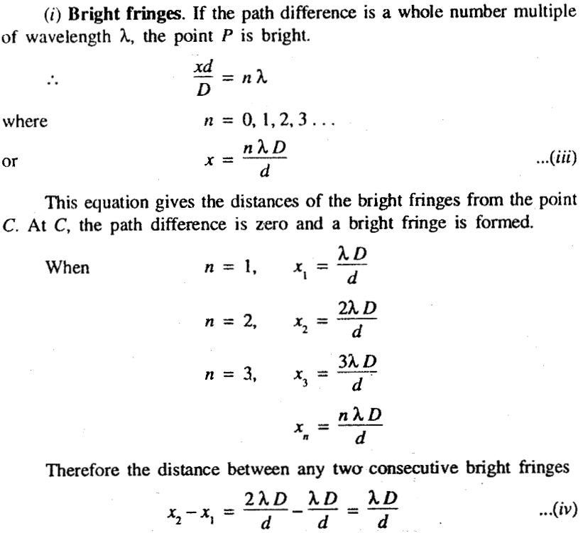
Theory of Interference Fringes

Slide 9
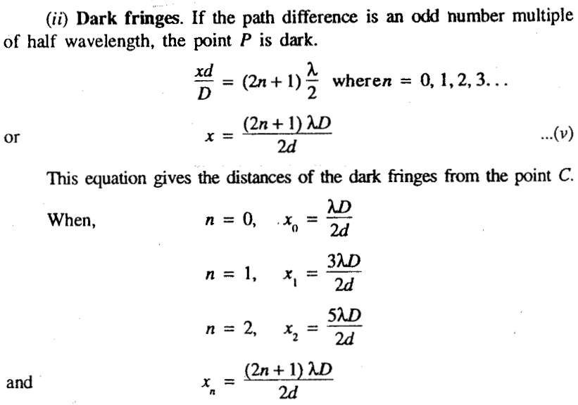

Slide 10
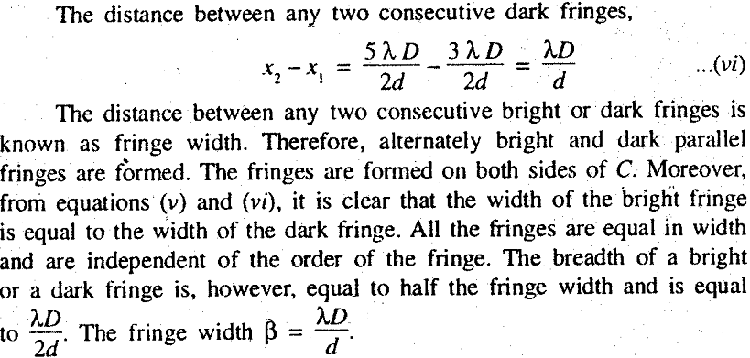

Slide 11
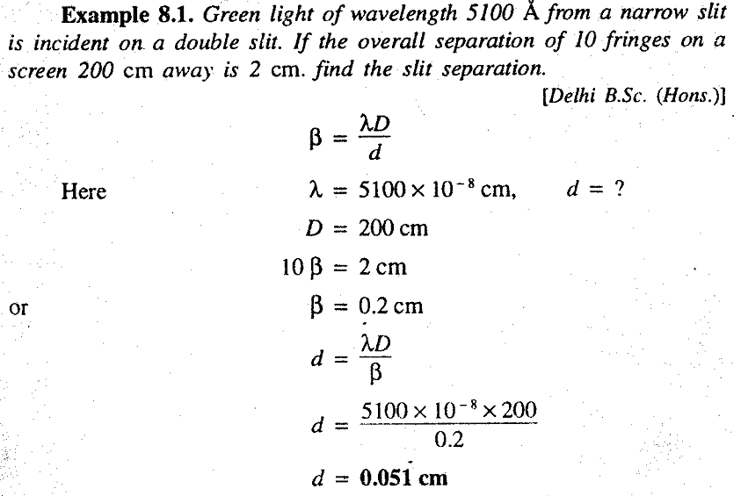
Related Mathematical Problems

Slide 12
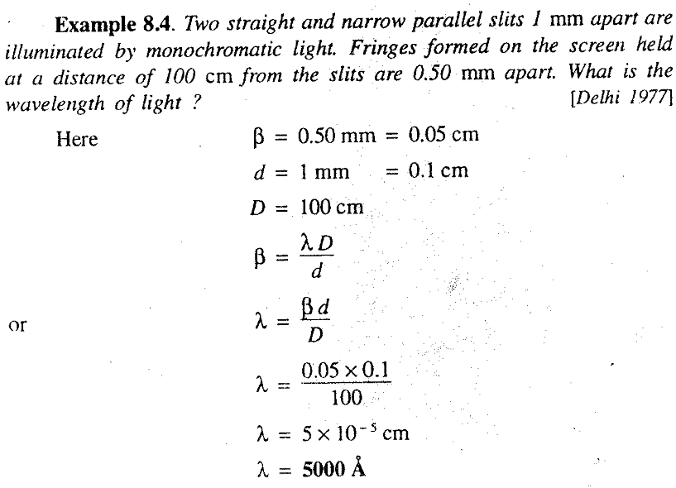

Slide 13
Similarly,
Example 14.2 (Page: 335)
Example 14.3 (Page: 335-336)
A Textbook of Optics- N. Subrahmanyam and Brijlal

Slide 14


